Slide 1
Fossil sand dollars, sea urchins, and sea biscuits gallery

Slide 2
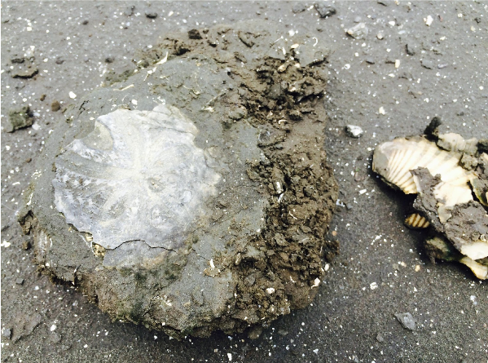
Fossil sand dollar found by teacher Erin at the Gatun Formation in Panama.

Slide 3
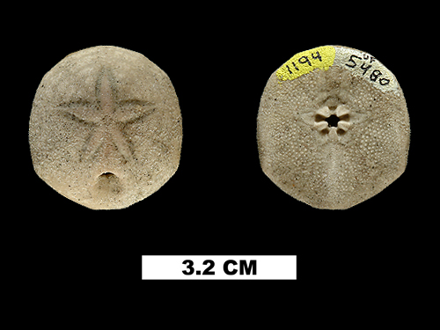

Slide 4
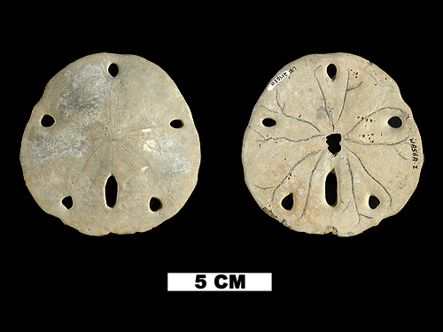

Slide 5
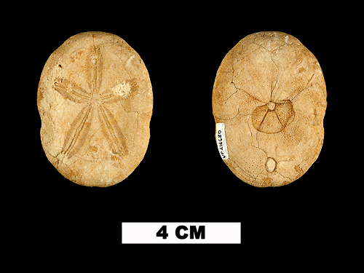

Slide 6
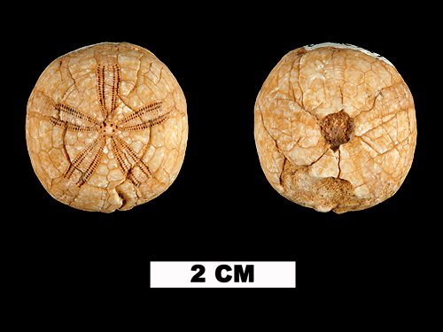

Slide 7
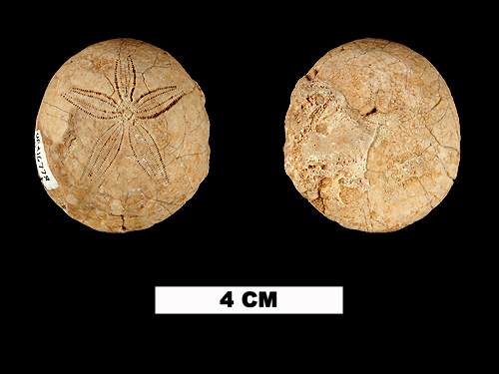

Slide 8
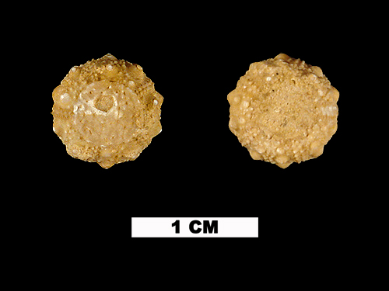

Slide 10
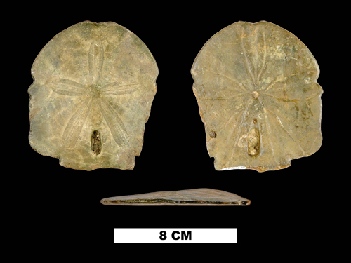
3D Model Available

